Slide 1

Power Efficient Approximate 4:2 Compressors for Imprecise 8 bit Multipliers circuit
Presented by:
SIDDHARTH SINGH UPADHYAY
MTECH IN VLSI & embedded system

Slide 2
CONTENT
DESIGN OF MULTIPLIER CIRCUIT 8 BIT
4:2 compressor using 1)XOR 2)MUX
HALF ADDER
FULL ADDER
8 BIT MULTIPLIER CIRCUIT
STAGE-1
STAGE-2
STAGE-3
TEST BENCH
OUTPUT
REPORT UTILIZATION

Slide 3
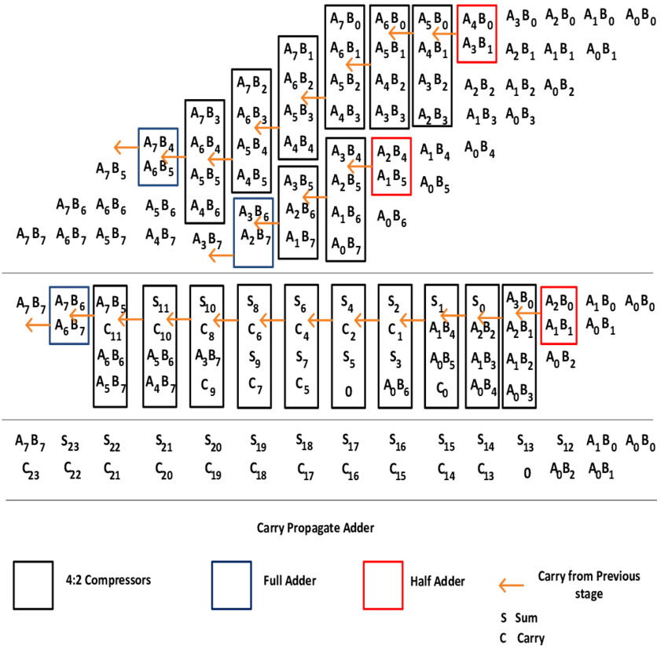
DESIGN OF MULTIPLIER CIRCUIT 8 BIT
MULTIPLIER 8 BIT
COMPRESSOR 4:2
FULL ADDER

Slide 4
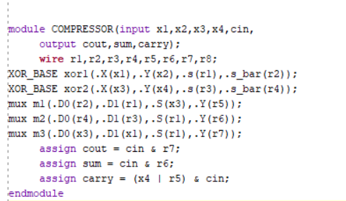
4:2 COMPRESSOR

Slide 5
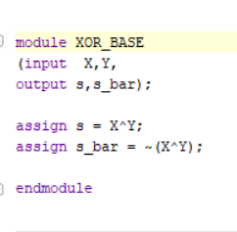
XOR GATE

Slide 6
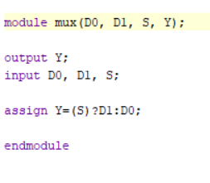
MUX

Slide 7
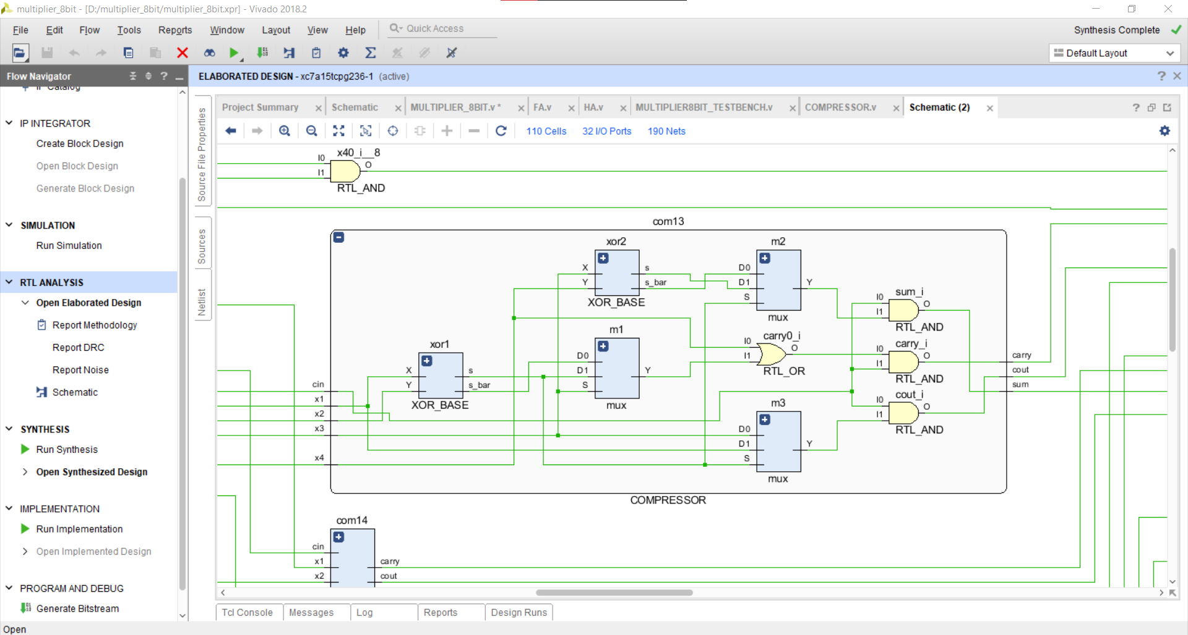
4:2 COMPRESSOR

Slide 8
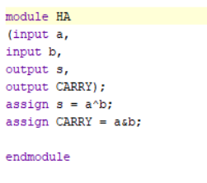
HALF ADDER

Slide 9
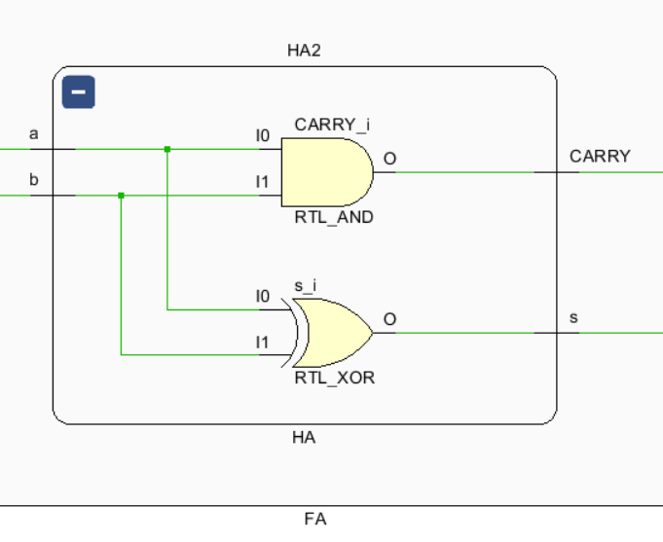
HALF ADDER

Slide 10
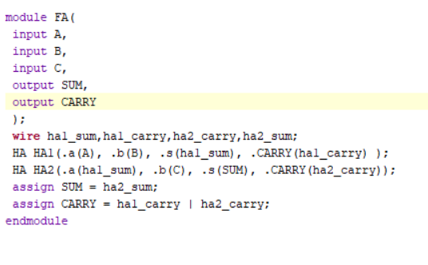
FULL ADDER

Slide 11
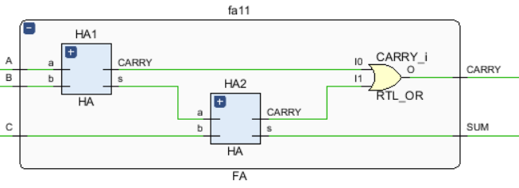
FULL ADDER

Slide 12
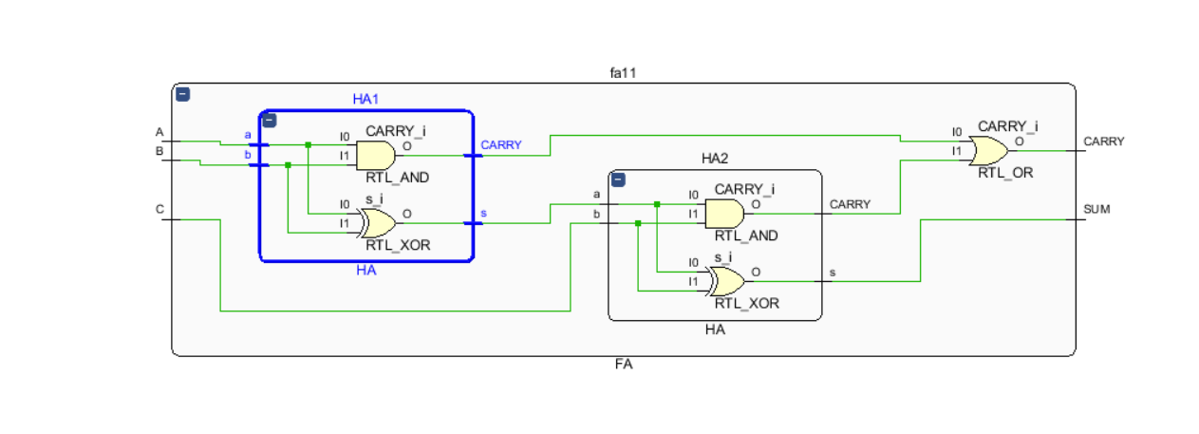
FULL ADDER

Slide 13

8 BIT MULTIPLIER

Slide 14
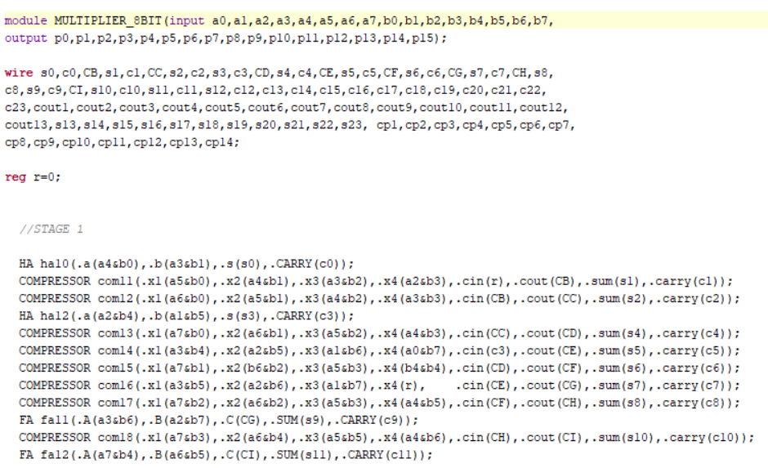
8BIT MULTIPLIER

Slide 15
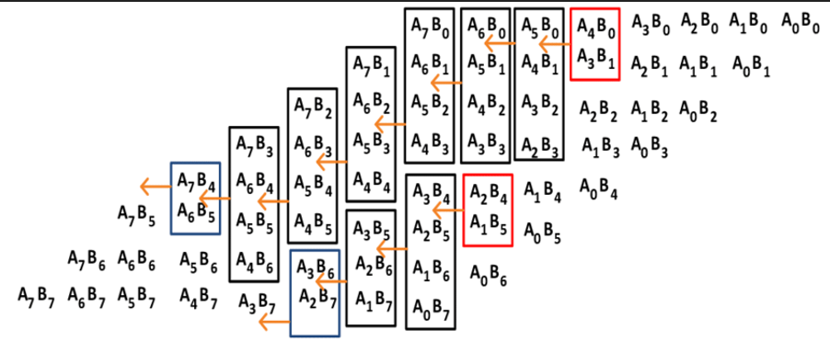
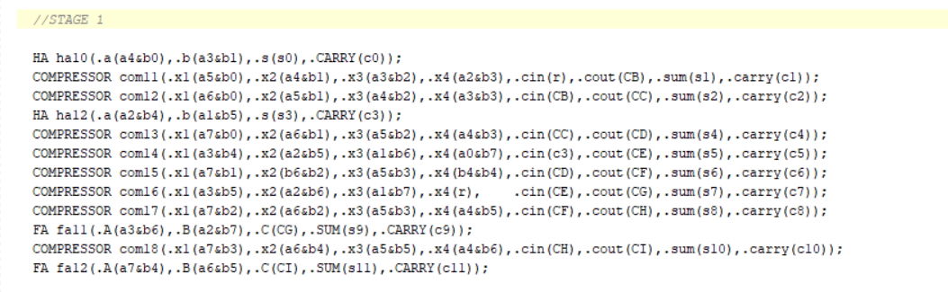
STAGE -1

Slide 16
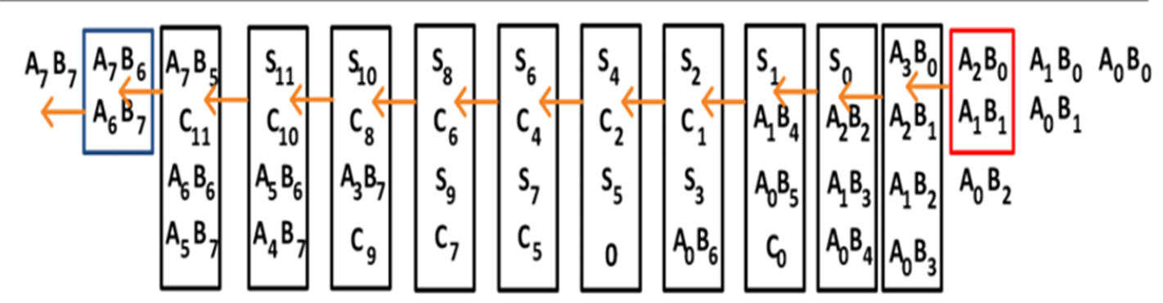
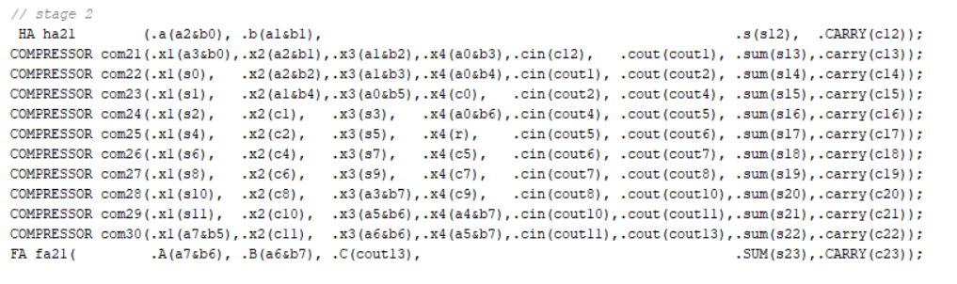
STAGE-2

Slide 17
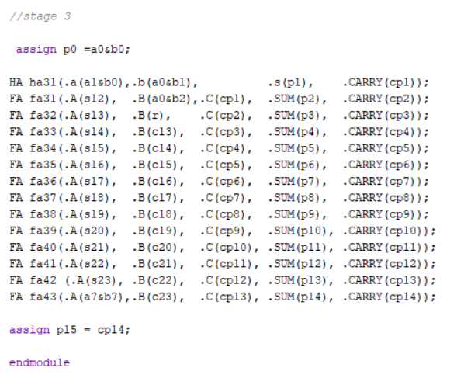
STAGE-3

Slide 18
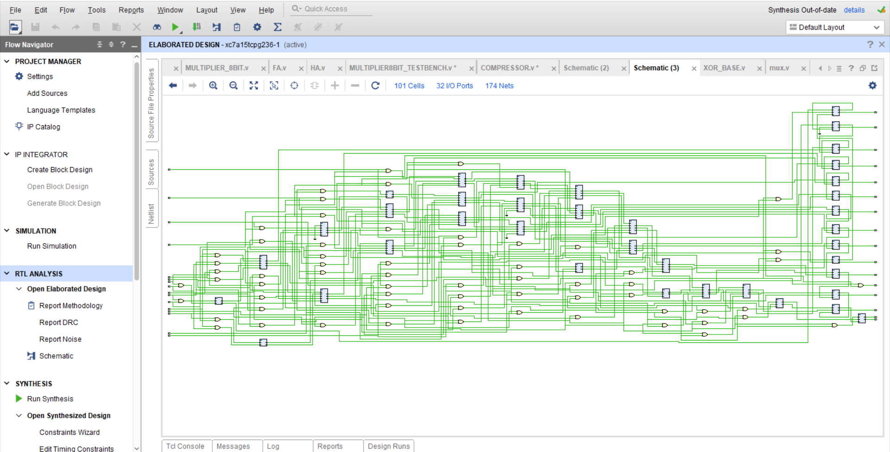
SCHEMATIC

Slide 19
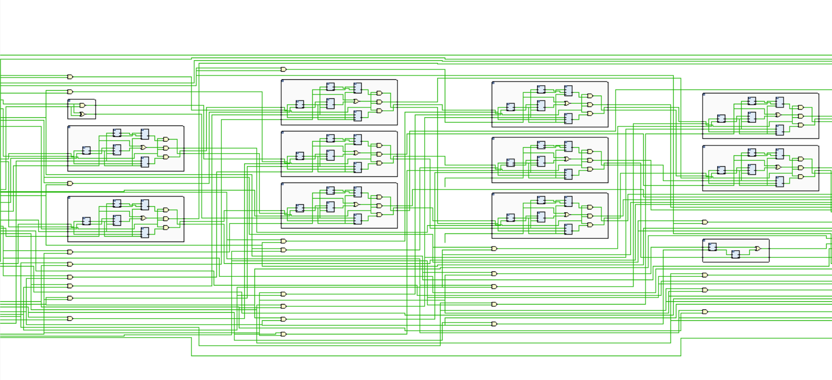

Slide 20
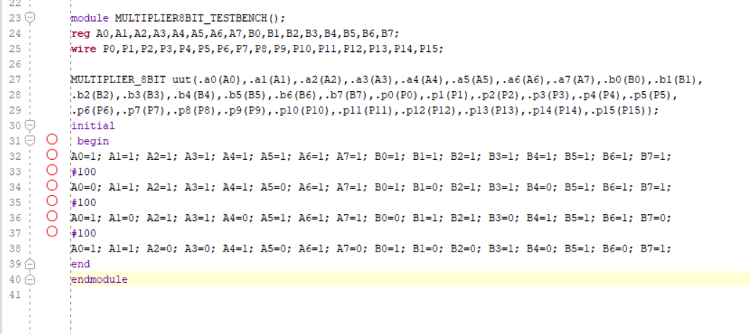
TEST BENCH

Slide 21
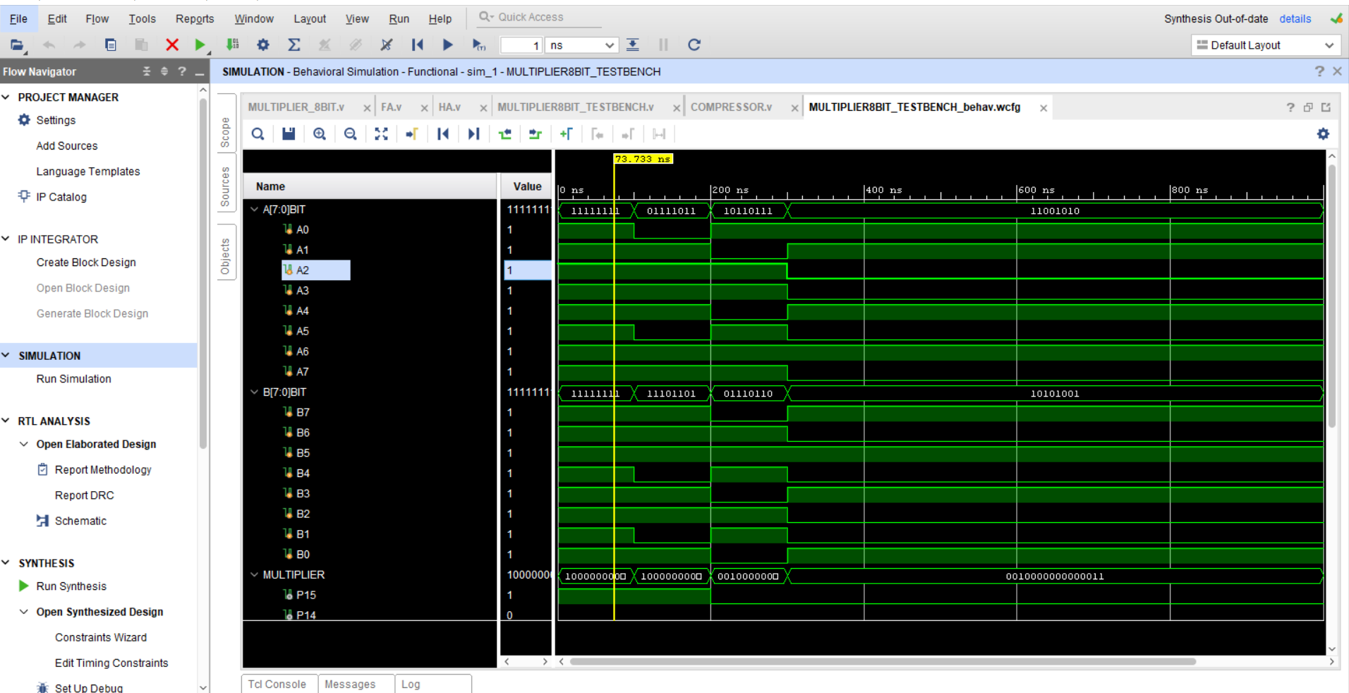
OUTPUT

Slide 22
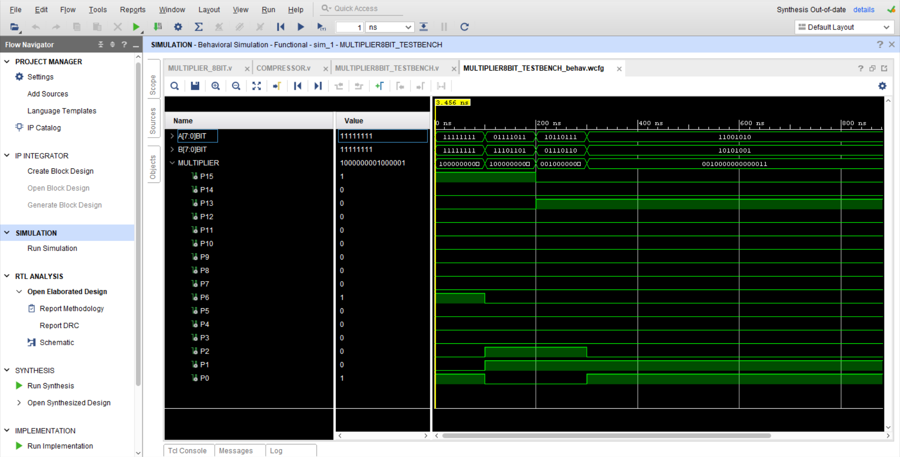

Slide 23
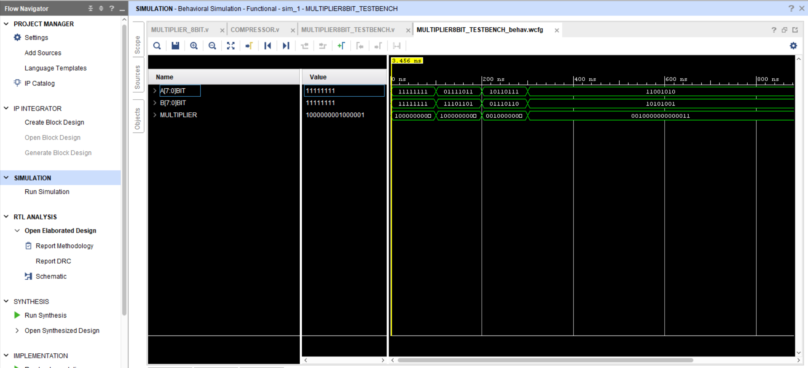

Slide 24
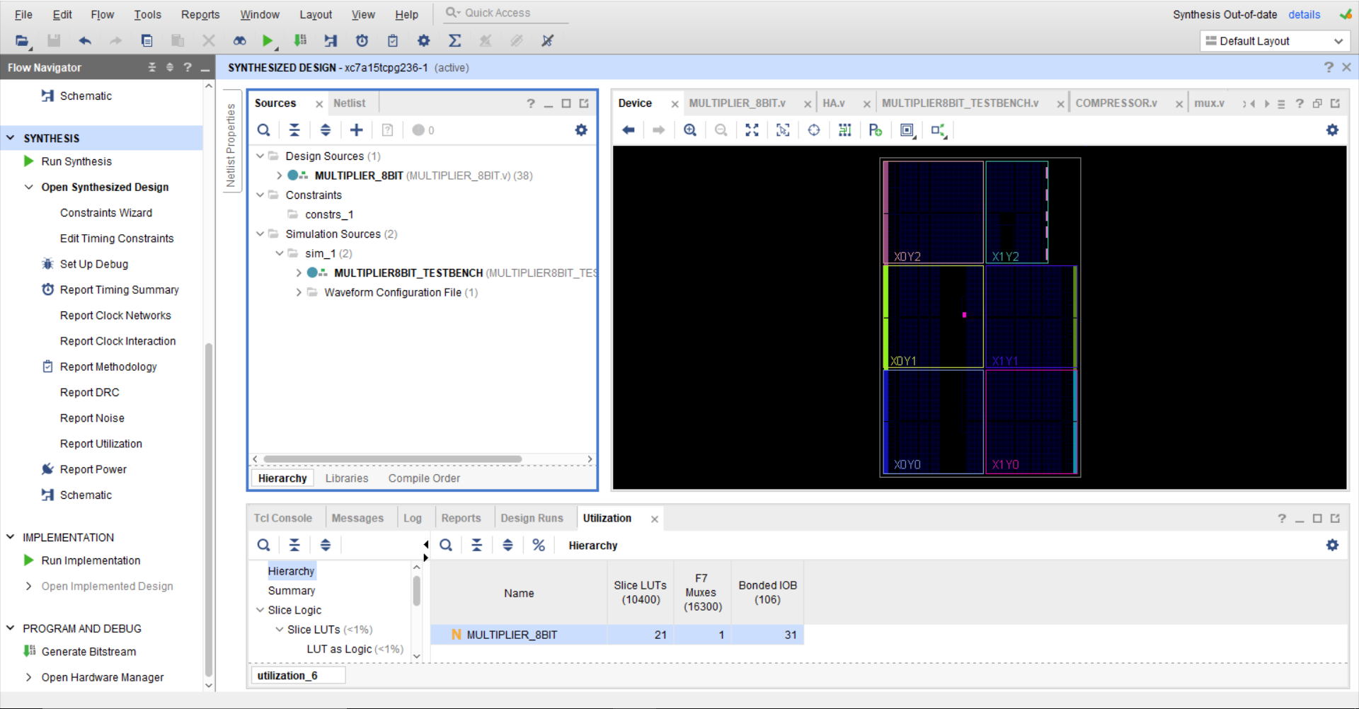
REPORT UTILIZATION

Slide 25
RESULT
We have design Power Efficient Approximate 4:2 Compressors using for Imprecise 8 bit Multipliers .

Slide 26
REFERENCES
Power Efficient Approximate 4:2 Compressors for Imprecise Multipliers VLSID research paper

Slide 27
THANK YOU

